Slide 1
NXT Parts Exploration
U1C4

Slide 2
1.4.2 NXT Parts Exploration
Overview:
This lesson gives students some further hands-on experience with various NXT kit parts. Student gain familiarity and confidence in working with the components and reinforce their understanding of the components' names and properties. The structural building challenge allows students to put this new knowledge to a practical test.
Objectives:
Students will be able to:
1. Identify the electronic components of the robotics system
2. List the electronic component of the robotics system
3. Describe the function of the electronic components of the robotics system
4. Describe the function of the wheel, gear, bushing and axle components of the robotics system
5. Describe the function of structural components of the robotics system
6. Describe the function of connector components of the robotics system
7. Apply knowledge of structural building techniques

Slide 3
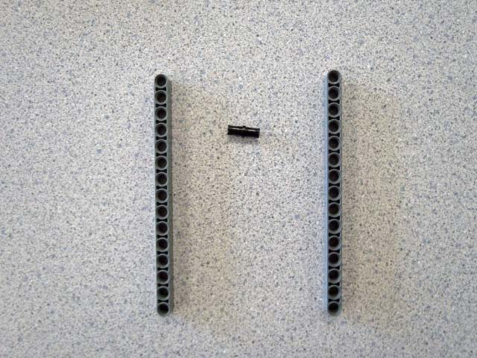
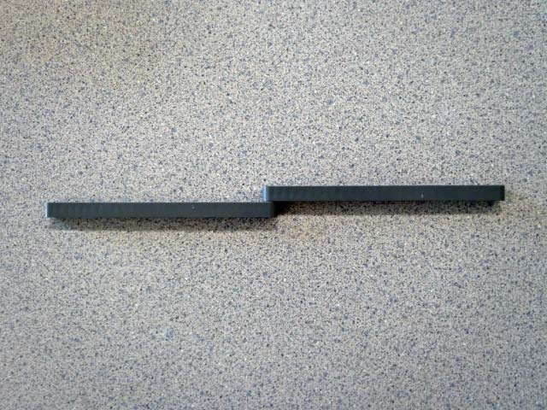
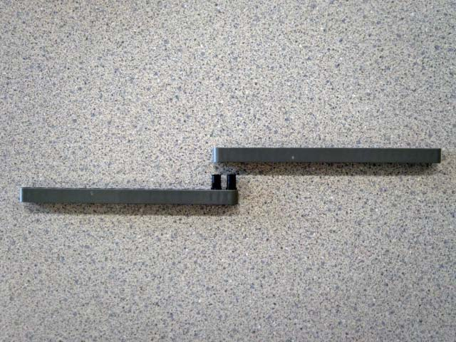
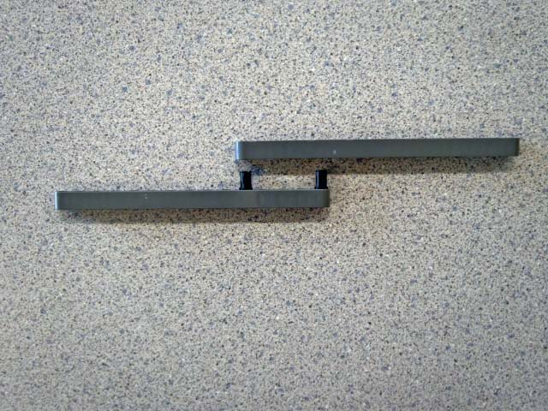
Structural Building: Longer Beams
Get these parts>>>>
2 15-hole beams
1 black peg
And build a longer beam:
like this>>>
How well does this work as a longer beam?
Why? What could we do to improve its strength?
Try this approach >>>
Why does this work better?
How could we make it stronger using only these same pieces?
Try this approach >>>
Why does this work better?
What’s the tradeoff for this better strength?
Notes:
In order to extend a straight beam, a minimum of two pegs must be used
The further apart the pegs are, the stronger the connection, but the shorter the resulting extended beam

Slide 4
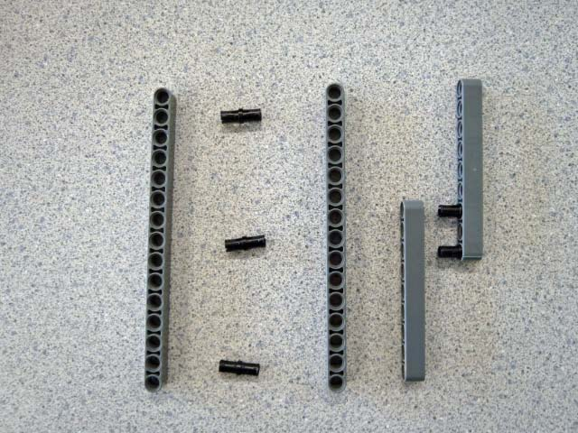
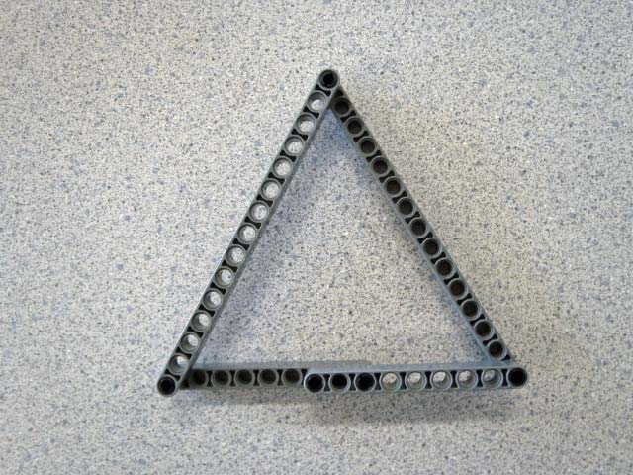
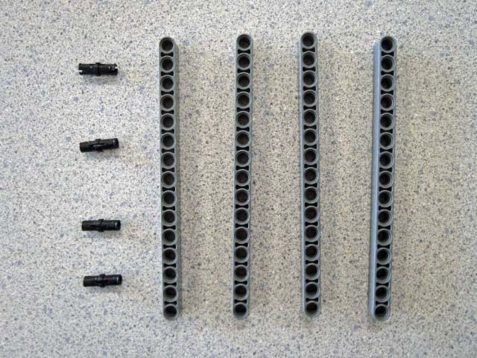
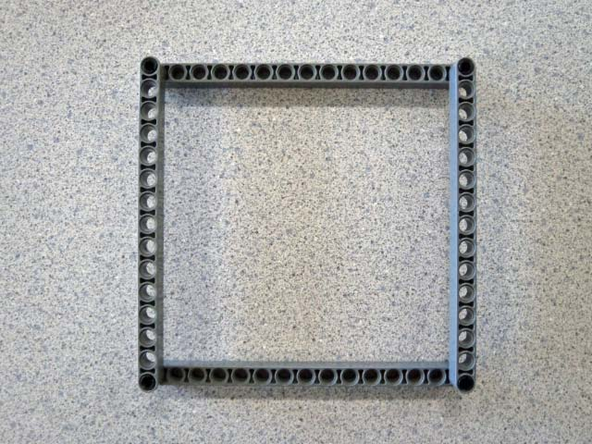
Structural Building: Shapes
Get these parts>>>>
2 15-hole beams
2 9-hole beams
5 black pegs
And build this triangle:
like this>>>
How sturdy is this shape?
Get these parts>>>>
4 15-hole beams
4 black pegs
And build this square:
like this>>>
How sturdy is this shape?
Why? What could we do to improve it’s strength? Try it.
Notes:
Triangles make very sturdy, strong structures – even when only attached by one peg
Rectangles (or squares) are not sturdy when only attached by one peg – they readily morph into parallelograms
to make rectangles sturdy, at least one corner must be locked at a right-angle – this will inhibit the other corners from moving too
the more corners locked, the stronger the rectangle
corners can be locked with angled beams and multiple pegs or by creating a triangle in the corner with another beam

Slide 5
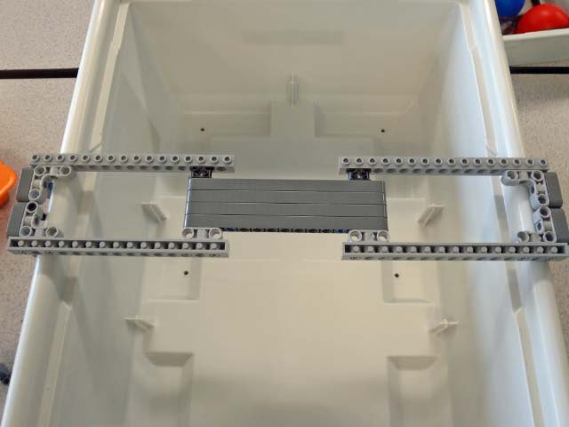
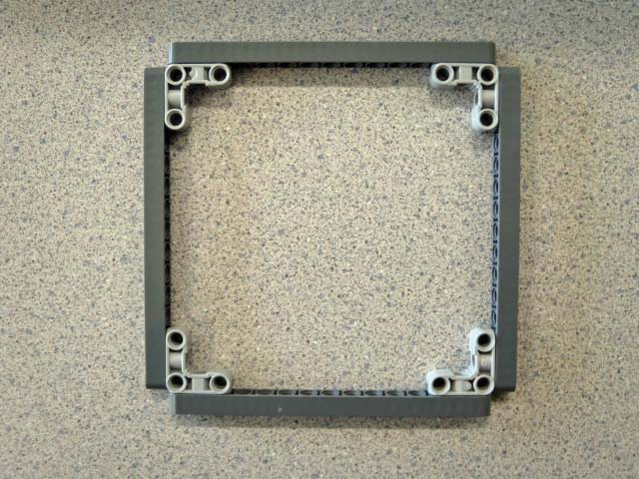
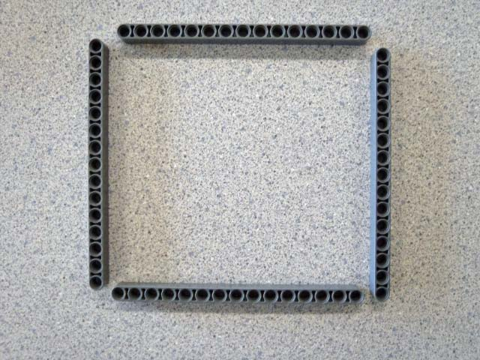
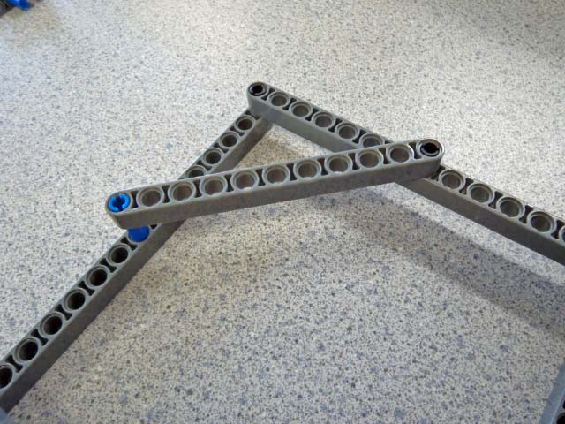
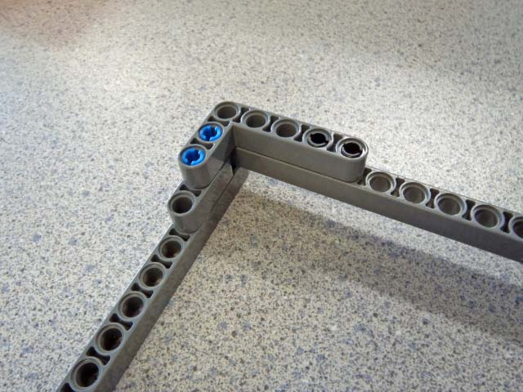
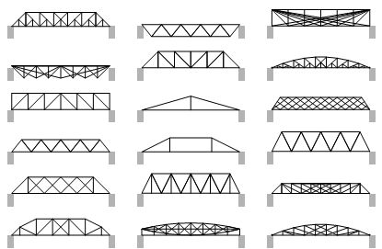
Structural Building: Shapes cont’d
Here are 2 possible solutions:
L- shaped brace on corner >>>
cross brace >>>
(remember that sturdy triangle?)
Try building a sturdy flat square:
like this >>>
(or with beams rotated)
Here’s 1 possible solution:
Snap beams make a quick-to-build and strong structure
Build a bridge which:
spans your NXT box
supports a heavy weight in the center
Here’s 1 possible solution >>>
( how could you use triangles to improve this design)
Notes:
To make rectangles sturdy, at least one corner must be locked at a right-angle – this will inhibit the other corners from moving too
the more corners locked, the stronger the rectangle
corners can be locked with angled beams and multiple pegs or by creating a triangle in the corner with another beam
A flat rectangle (or square) presents other challenge
locking these corners will take many pieces unless….
This snap-beam part creates a very fast, efficient and effective means of accomplishing this
If students try the snap-beam first, have them also try to solve this without using the snap-beam so they appreciate the elegance of this solution
The mini-bridge challenge gives students a chance to put this new learning into practice
Have students build their bridges
Encourage then to not simply create a plank bridge (as in the example photo) but also think about how to use triangles to make it stronger
creating triangles on the side of the bridge where one side is two beams on the bridge deck (that will bow together when weight is added) and the other two sides are additional beams connected above the bridge deck will increase the load capacity of the bridge deck
Test the student bridges by incrementally adding weight
Discuss why some bridges to better than others
Examine the point of failure on bridges that collapse early
Discuss ways these could be improved

Slide 6
NXT Parts Exploration
CMU Technical Primer Flash – Construction Techniques
  http://stemrobotics.cs.pdx.edu/sites/default/files/technicprimer.swf
  Physics of Arches
  http://www.teachersdomain.org/asset/nv37_int_arches/
  LEGO Digital Designer CAD Tool
  Lego Digital Designer
Notes:
Instructional Material: CMU Technical Primer Flash
Construction Techniques
This Technic Primer [10] is a resource form Carnegie Mellon Univerisity's Robotics Academy (http://www.education.rec.ri.cmu.edu/ [11]) Robotics Engineering Vol. 1 product (http://www.education.rec.ri.cmu.edu/content/lego/curriculum/rev1_index.htm [12]).
Joining Pieces (examples 1 thru 4)
Student can construct 4 assemblies using different friction pegs and beams
Stationary Axles (examples 1 and 2)
Students can construct 2 assemblies using axles as structural elements
Optional : Reinforcing Structures and Size Scale
Student will not use these techniques soon or often – may be overkill at this point
Optional : Pulleys, Cam Rods and Axis of Rotation
Student will not use these techniques soon or often – may be overkill at this point
Gears
Assemble Gear Train (steps 1 thru 4 in primer)
Add 3 bushings to secure gears (similar to Photo 1_1 [13])
Note ease of motion
Alter assembly to use 3 non-friction pegs (tan colored) instead of axles
Note ease of motion
Alter assembly to use 3 friction pegs (blue colored)
Note difficulty of motion

Slide 7
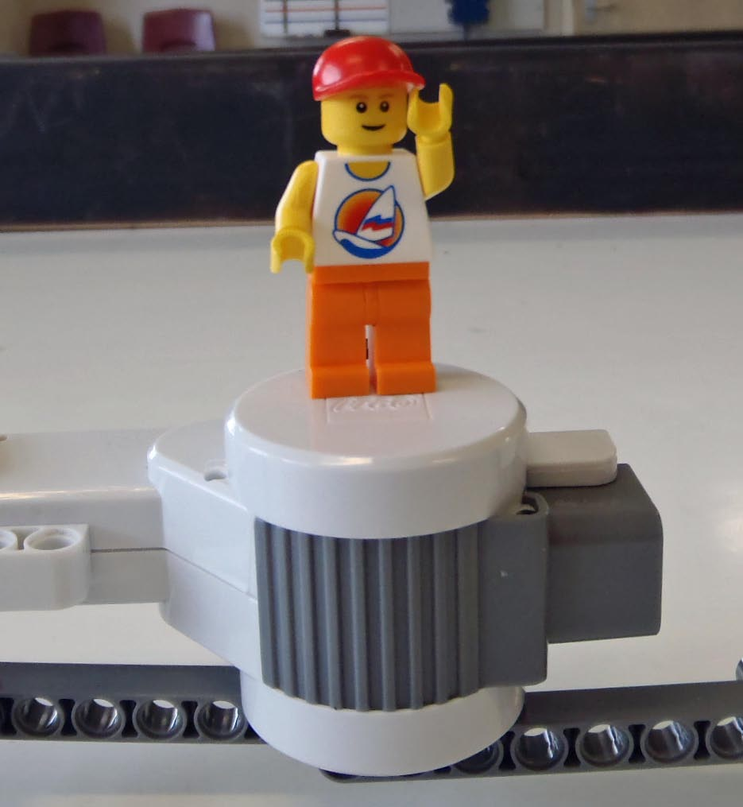
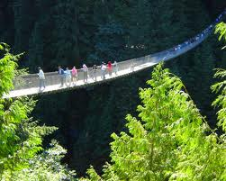
Structural Building Challenge
Build a bridge which:
  spans the arena (doesn’t touch the whiteboard)
  suspension design (only touches black boards at each end)
  is self-supporting (you can’t hold on to it)
  can support Lego dude standing on a motor in the center
  uses the non-electronic parts from only one kit
  uses the fewest number of parts
Notes:
This challenge is all about build long-and-strong (slide 1)
The structural building learning (slides 2,3) can be assessed in the Faraday Golf Challenge
As an extended challenge, have students place the brick/battery between the bridge and motor/dude for an additional load on the bridge

Slide 8
Structural Building Challenge Grading
Build a bridge which:
  spans the arena 2 pts
  suspension design 2 pts
  is self-supporting 2pts
  uses the non-electronic parts from only one kit 2 pts
  can support Lego dude standing on a motor @ center 2 pts
  uses the fewest number of parts bonus
                < 50 1 pts
                < 40 2 pts
                < 35 3 pts
                Have Fun!!
Team: ____________________
Members: _________________
_________________
Number of Parts: ____
1) Get another team sign off on each of the bullets above
2) Then get a final sign-off from the teacher
Notes:
Print out this grading sheet for students

Slide 9




Assessment: Quiz 1.4.7b
NXT Parts Exploration Unit Level Quiz
Explain how these 3 pegs are different (other than their color).
(color: tan)
(color: blue)
(color: black)
Give an example of how each could be used:
Name this part, and describe 2 ways it can be used:

Slide 10
Let’s Build a Tower
Using only the non-electronic pieces from one kit, build a tower that will hold 3 Into to the Navy NJROTC (white) books. The tower should be wide enough to hold the books without tipping over and strong enough to hold them.
Remember to use squares and triangles in your design to give the strength and stability needed to hold the books.
Height Points: Add 1 point for every ½ in over 6 inches.
After reaching the height requirement of 6 inches, then: Strength Points: Add 2 points for each book after the 3rd.

Slide 11
Let’s Build a Tower Challenge Grading
Build a tower which:
  minimum height = 6in 2 pts
  uses squares and triangles for
  strength and stability needed to hold the books. 2pts
  uses the non-electronic parts from only one kit 2 pts
  can support 3 Into to the Navy NJROTC books 2 pts
  tower should be wide enough to hold the books without tipping over and strong enough to hold them. 2 pts
  Height Points: Add 1 point for every ½” over 6”.
  Strength Points: Add 2 points for each book after the 3rd.
                Have Fun!!
Team: ____________________
Members: _________________
_________________
½ increments over 6”: ____ x 1 pts = _______
Books stacked over 3 : ____ x 2 pts = _______
1) Get another team sign off on each of the bullets above
2) Then get a final sign-off from the teacher
Notes:
Print out this grading sheet for students

Slide 13
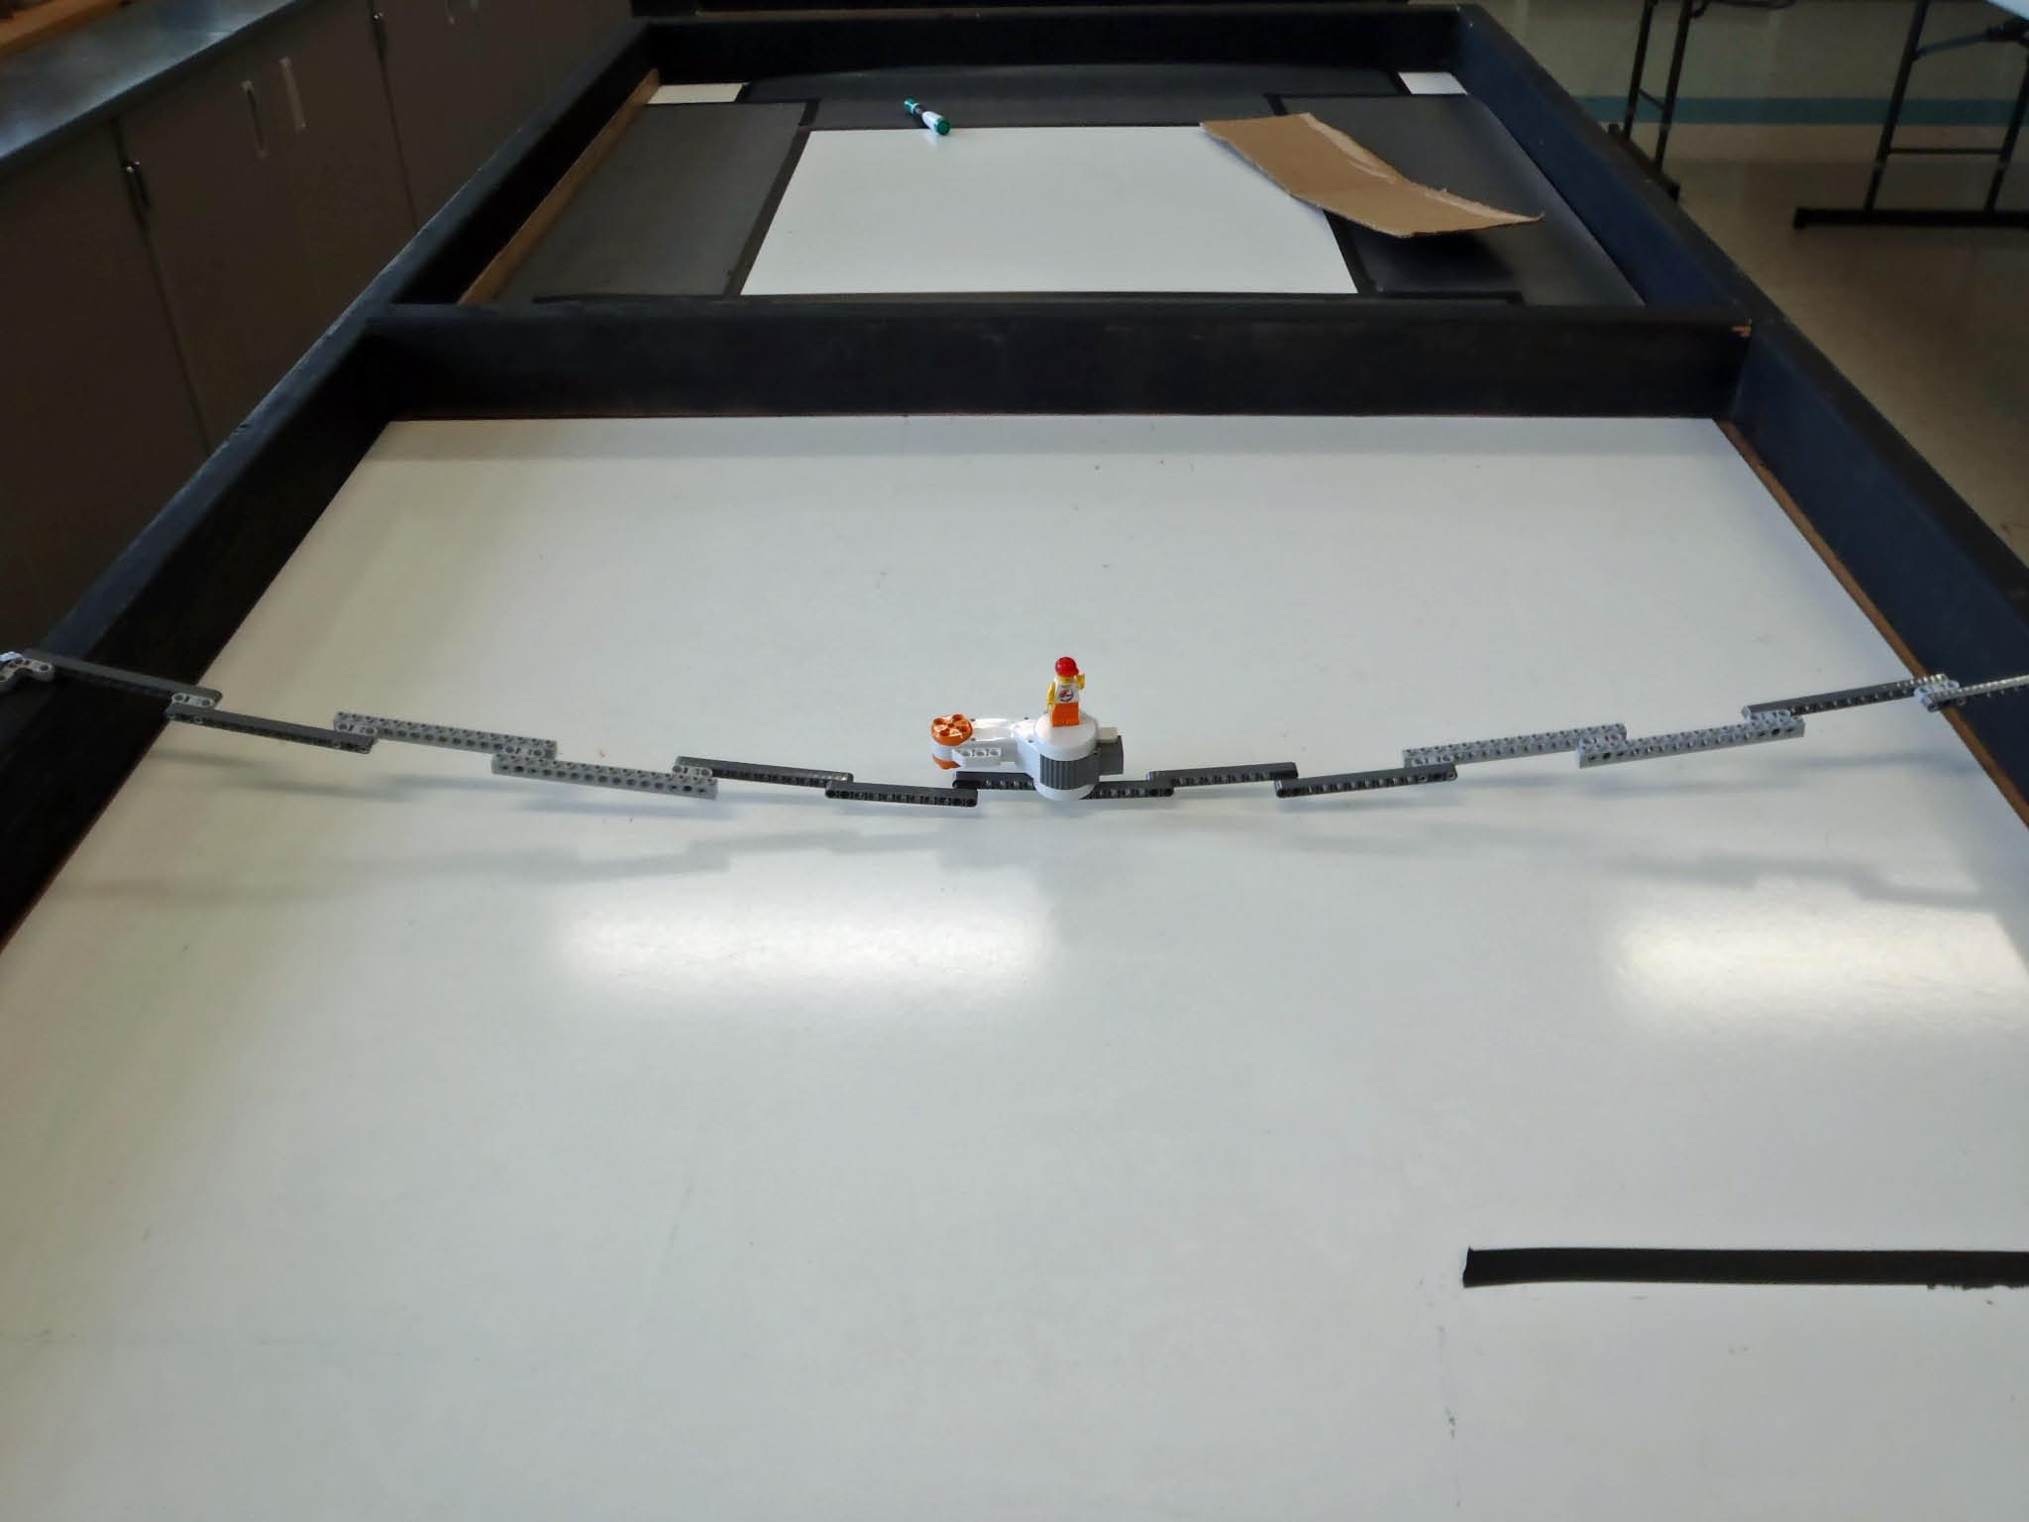
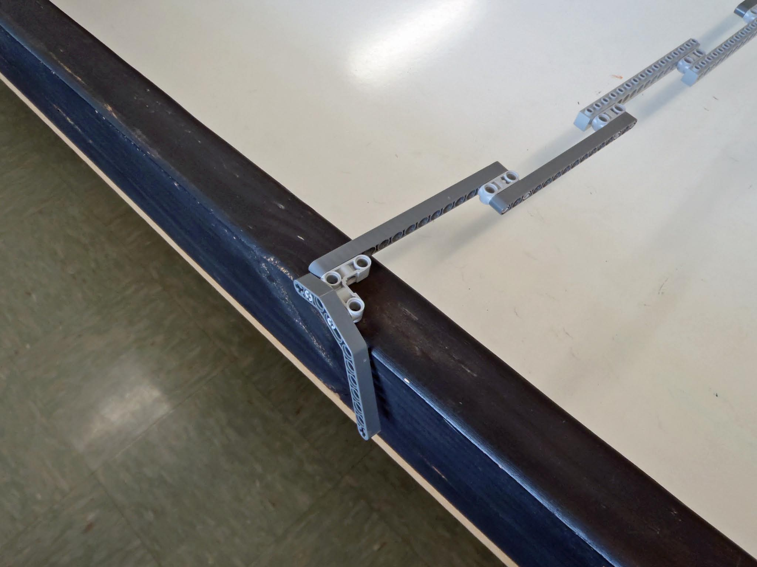
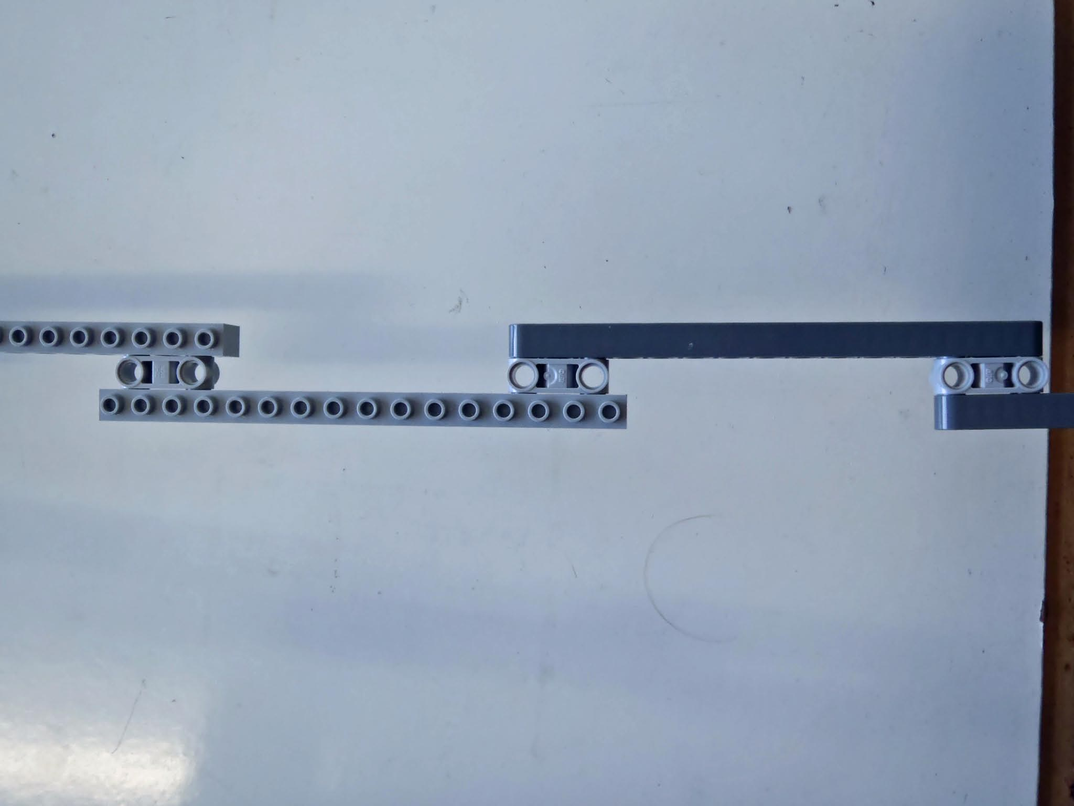
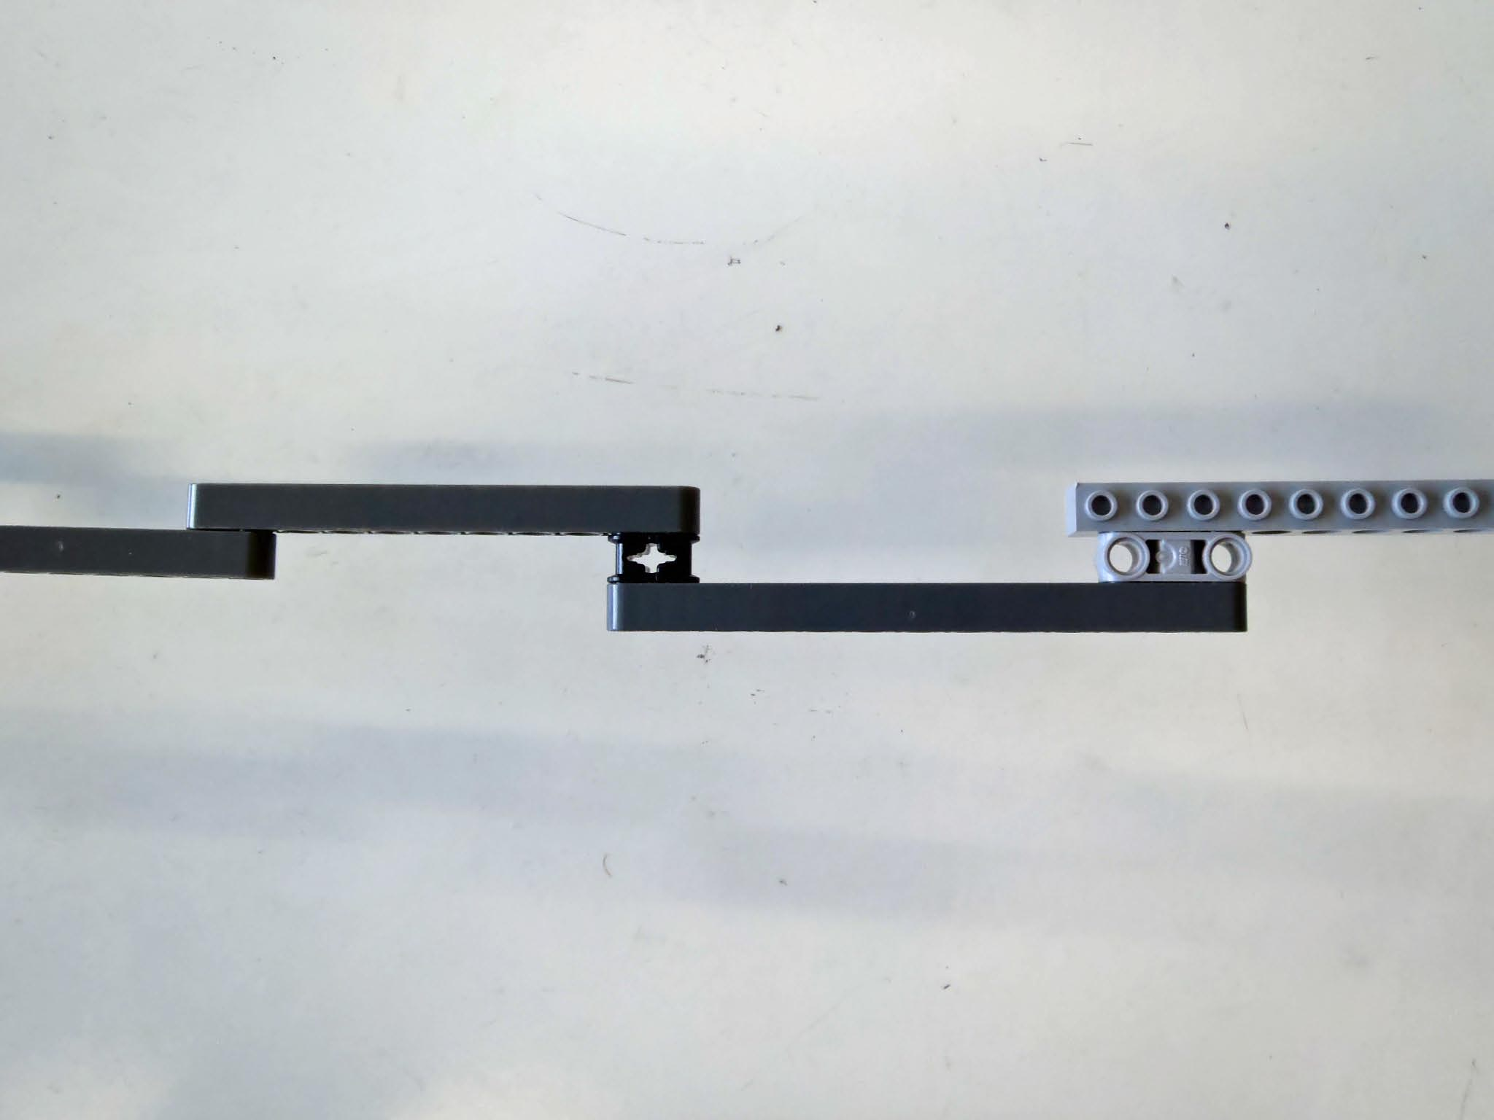
One Possible Solution (34 parts):
Notes:
Note: the kit used in this example had 6 straight snap-beam more than the standard 9797 kit

Slide 14
Structural Building Challenge Grading
Team: ____________________
Members: _________________
_________________ _________________
Build a bridge which:
  ___ spans the arena = 2 pts
  ___ suspension design = 2 pts
  ___ is self-supporting = 2pts
  ___ uses the non-electronic parts from only one kit = 2 pts
  ___ can support Lego dude standing on a motor @ center = 2 pts
  ___ uses the fewest number of parts bonus
                < 50 1 pts
                < 40 2 pts
                < 35 3 pts
                Have Fun!!
Lesson 1.4.7a
Period_______
Date ________
#of Parts: ____
2nd Team: ________
___ 2nd Team Grade
___ Teachers Grade
1) Get another team sign off on each of the bullets above
2) Then get a final sign-off from the teacher
Notes:
Print out this grading sheet for students

Slide 15
Let’s Build a Tower Challenge
Build a tower which:
    ___ minimum 6in height = 2 pts
  ___ uses squares and triangles for
  strength and stability needed to
  hold the books. 2pts
  ___ uses the non-electronic parts from only one kit 2 pts
  ___ can support 3 Into to the Navy NJROTC books 2 pts
  ___ tower should be wide enough to hold the books without tipping over
  and strong enough to hold them. 2 pts
  ___ Height Points: Add 1 point for every ½” over 6”.
  ___ Strength Points: Add 2 points for each book
  after the 3rd.
                Have Fun!!
Team: ____________________
Members: _________________
_________________ _________________
Lesson 1.4.8a
Period_______
Date ________
2nd Team: ________
___ 2nd Team Grade
___ Teachers Grade
½ increments over 6”: ___ x 1 pts = _______
Books stacked over 3 : ___ x 2 pts = _______
1) Get another team sign off on each of the bullets above
2) Then get a final sign-off from the teacher
Notes:
Print out this grading sheet for students

